Slide 1
Fuzzy Families The Role of Parental Attitudes in Religious Decline
Simon Brauer
Ph.D. Candidate
Sociology, Duke University

Slide 2
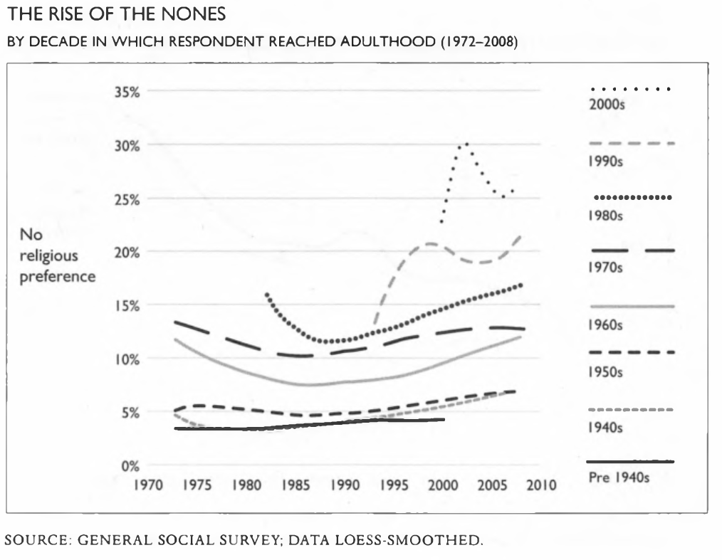
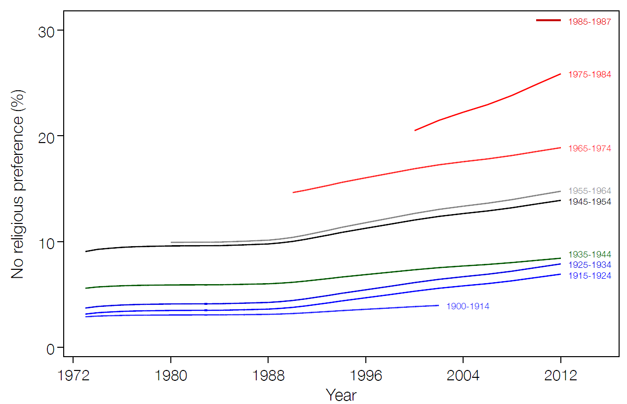
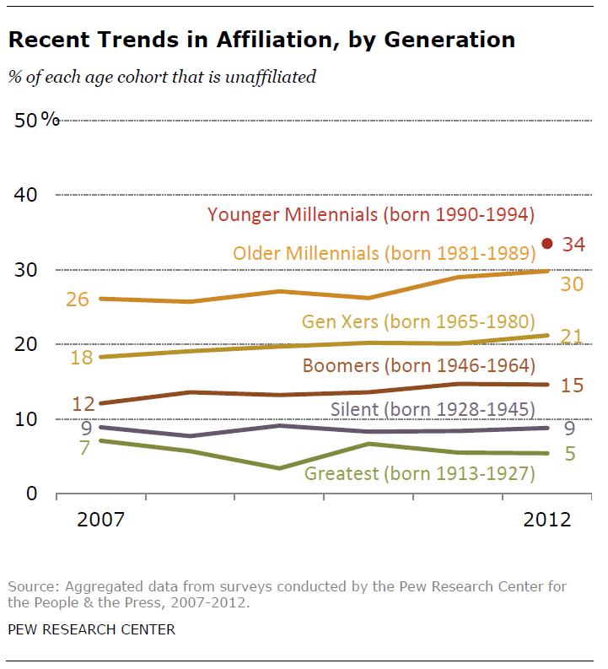
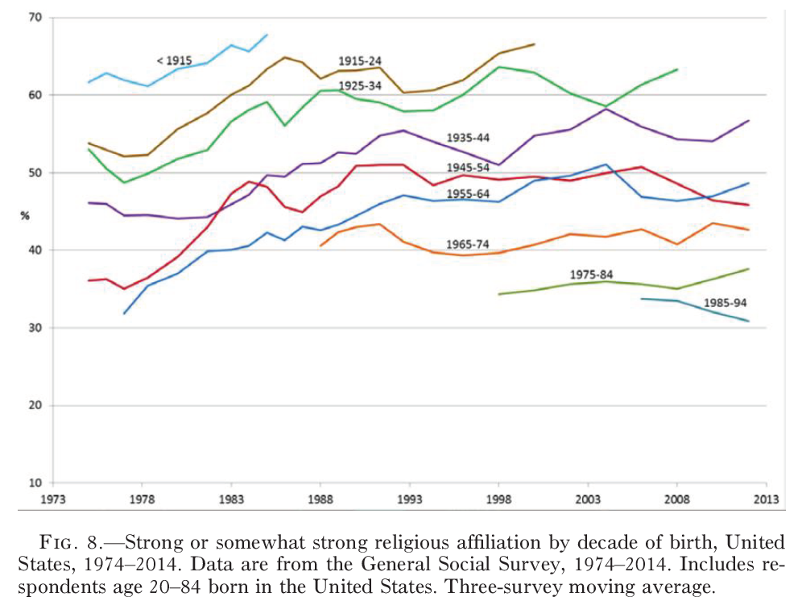
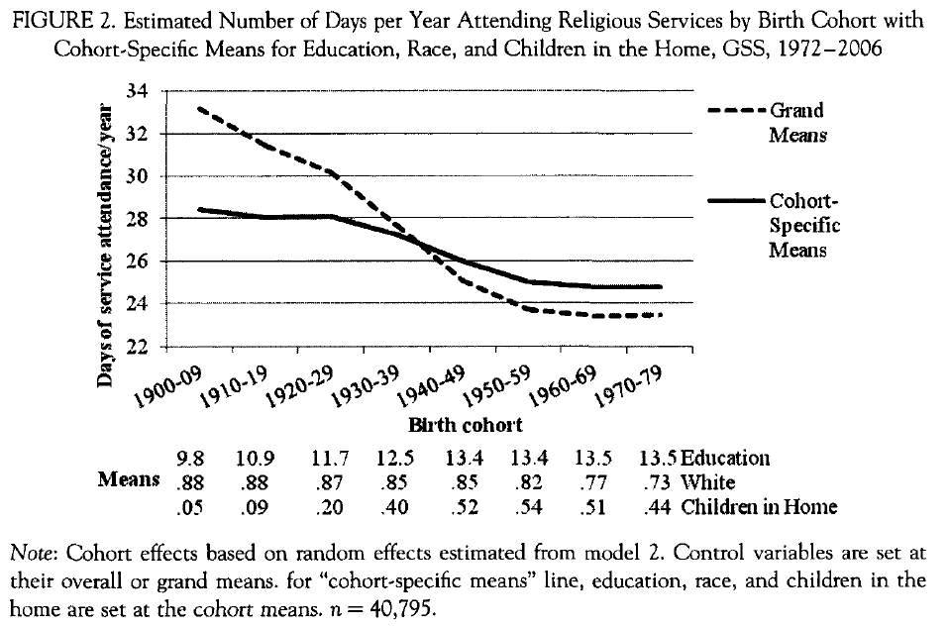

Slide 3
Religious transmission in the family
The most effective parents…
…are married
…have similar religious beliefs
…have beliefs that differ significantly from surrounding the cultural context

Slide 4
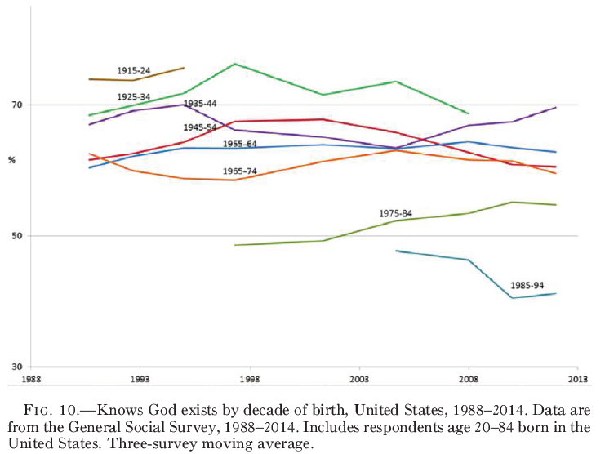
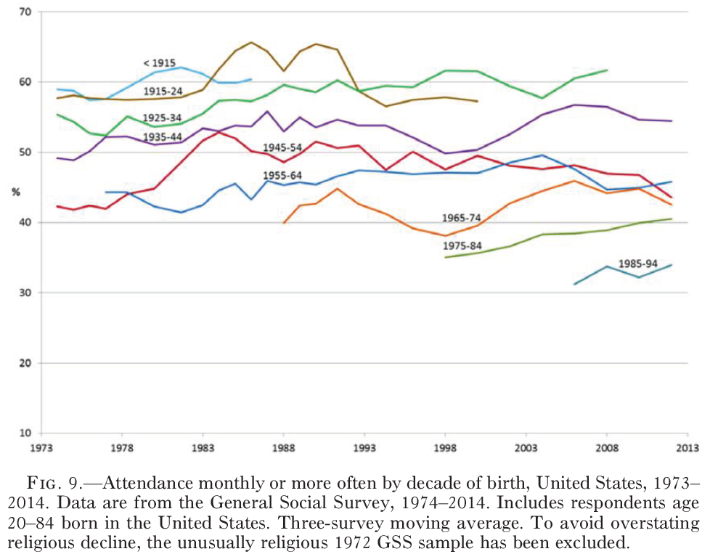

Slide 5
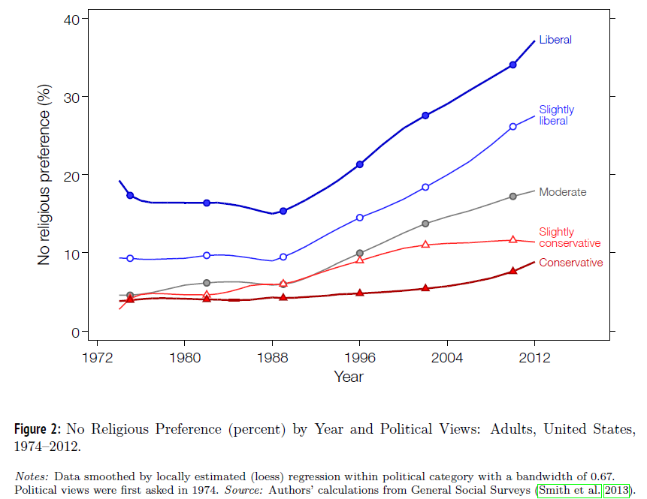
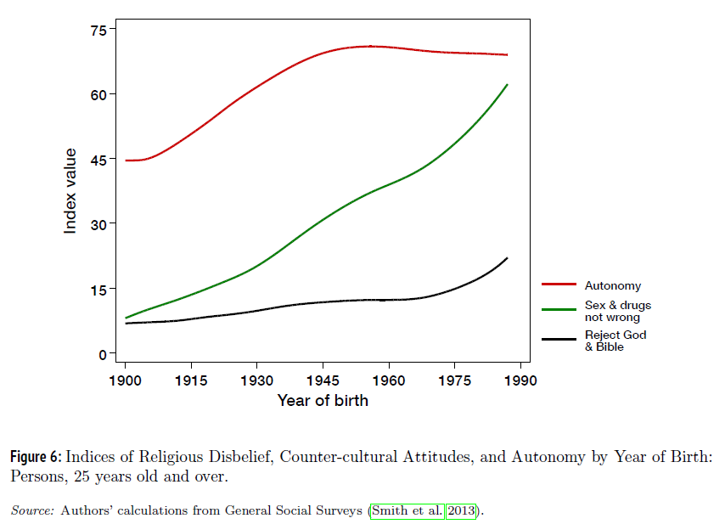

Slide 7
Challenged religion in contemporary society
The “God problem”
The “secular option”
Pluralism and cognitive contamination
Is religious transmission impacted?

Slide 8
Data
Longitudinal Study of Generations (LSoG)
Sample of 419 Californian families
Started as a 3-generation sample in 1971
Added a 4th generation in 1991
Using 8 waves between 1971 and 2005

Slide 9
Religiosity (Voas’ categories)
Religious
Describe themselves as “moderately” or more religious (self-report)
Attended religious services at least several times a year OR strongly agreed that religion was the most important influence in their life OR religion was in the top three of nine values ranked by the respondent

Slide 10
Religiosity (Voas’ categories)
Secular
Describe themselves as “Not at all religious” (self report)
Never attend religious services
Strongly disagreed that religion was the most important influence in their life
Religion was 8th or 9th most important value (out of 9)

Slide 11
Respondent variables
Year of birth
Standardized
Female
Income
Standardized
Political position
[1] Very liberal [5] Very conservative

Slide 12
Respondent variables
Closeness to each parent
[1] Not at all close [6] Extremely close
Communication with each parent
[1] Not good [6] Extremely good
Conflict with each parent
[1] Not at all [5] Quite a bit
Whether parents divorced before child turned 19

Slide 13
Parent variables
Religious category
Secular as the reference
Country would be better off if religion were more influential
[1] Strongly agree [4] Strongly disagree
Every child should have religious instruction
[1] Strongly agree [4] Strongly disagree

Slide 14
Parent variables
People should change their values if they conflict with family’s values
[1] Strongly agree [4] Strongly disagree
Rules should be flexible when raising children
[1] Strongly agree [4] Strongly disagree

Slide 15
Parent variables
Education
[1] Less than high school [5] More than bachelor’s
Works full time
Family income
Standardized
Political views
[1] Very liberal [5] Very conservative

Slide 16
Analyses
Restructured the data
Averaged across survey waves for each respondent
Multilevel ordinal logistic regression
Respondents nested in families
Models, separate for mother and father
Baseline model: child religious category predicted by year of birth and parents’ religious category
Full model: Added the remaining variables, including characteristics of the parent-child relationship, parental attitudes, controls

Slide 17
Results

Slide 18
 | Count |  | Mean | SD
Sex
Male | 950 | 45%
Female | 1,174 | 55%
Generation
2nd | 481 | 23%
3rd | 876 | 41%
4th | 770 | 36%
Religiosity
Secular | 181 | 9%
Fuzzy | 852 | 42%
Religious | 1003 | 49%
Year of birth |  |  | 1950.40 | 17.3

Slide 19
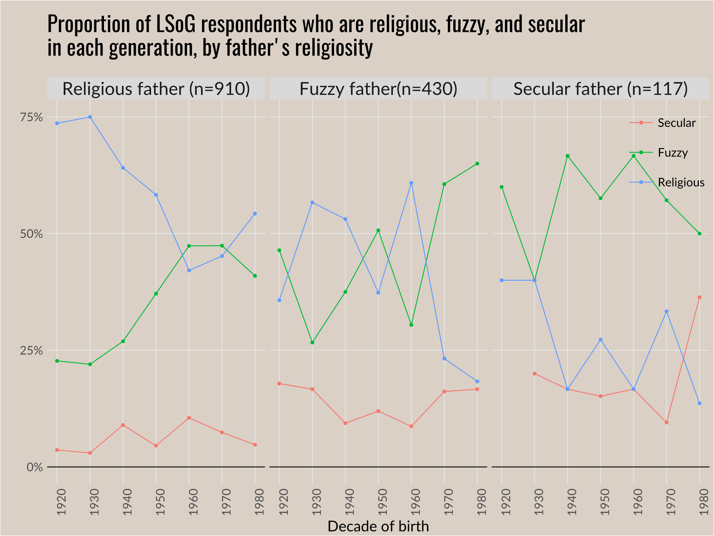

Slide 20
Parent's Religiosity
Religious
Fuzzy
Year of birth (scaled)
Female
Income
Political conservatism
Parents divorced
Parental closeness
Parental communication
Parental conflict
Society better with religion
Religious instruction
Should change values
Flexible rules
Parental education
Parental income
Parent works full time
Parent's political conservatism
 | Mother (n=2,101) | Father (n=2,101)
 | 0.85*** (0.17) | 0.81*** (0.14)
 | 0.12 (0.12) | 0.11 (0.10)
 | -0.51*** (0.07) | -0.51*** (0.07)
 |  |  | Mother (n=1,978) | Father (n=1,978)
 |  |  | 0.51** (0.18) | 0.48** (0.14)
 |  |  | 0.14 (0.12) | 0.13 (0.1)
 |  |  | -0.34*** (0.09) | -0.38*** (0.1)
 |  |  | 0.48*** (0.1) | 0.52*** (0.1)
 |  |  | -0.17** (0.05) | -0.18** (0.05)
 |  |  | 0.61*** (0.06) | 0.65*** (0.06)
 |  |  | -0.16 (0.11) | -0.1 (0.11)
 |  |  | 0.12 (0.07) | 0.15* (0.07)
 |  |  | 0.24** (0.08) | 0.24** (0.07)
 |  |  | 0.13* (0.06) | 0.2*** (0.05)
 |  |  | -0.27*** (0.06) | -0.24*** (0.06)
 |  |  | 0.01 (0.05) | -0.02 (0.05)
 |  |  | -0.03 (0.05) | -0.03 (0.05)
 |  |  | 0.01 (0.06) | 0.15* (0.06)
 |  |  | -0.03 (0.05) | 0.06 (0.04)
 |  |  | 0.03 (0.05) | -0.11 (0.06)
 |  |  | -0.03 (0.11) | 0.22 (0.13)
 |  |  | 0.1* (0.05) | 0.04 (0.05)

Slide 21
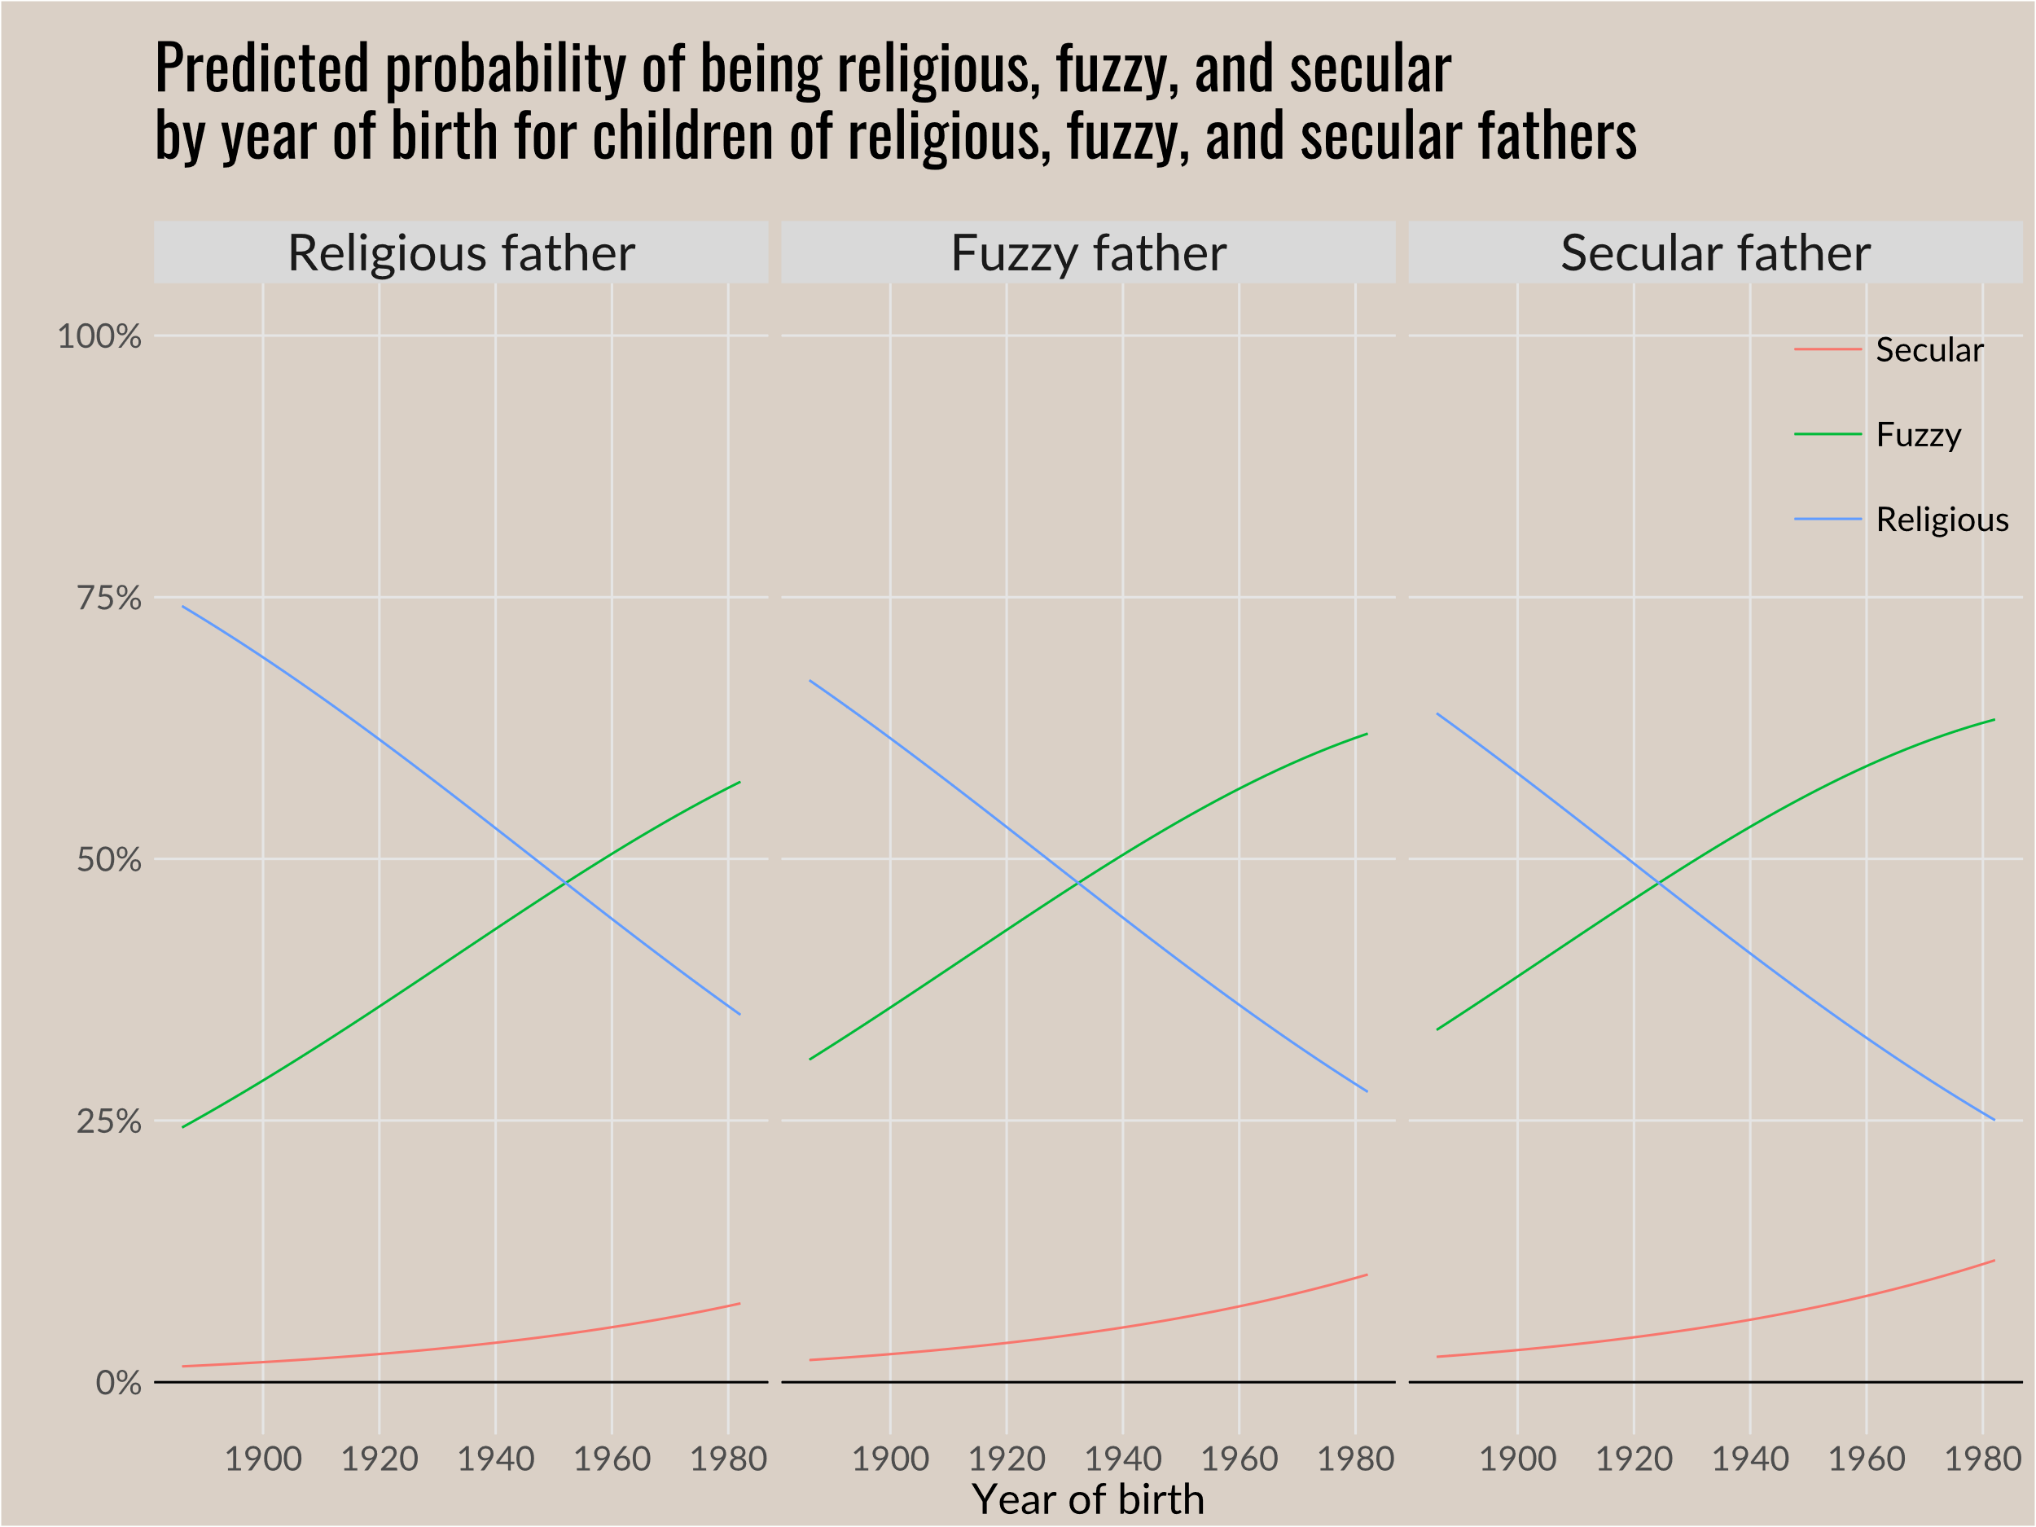
Notes:
Previously used ‘relig’ but has been updated with ‘reltrad.’ The main difference is fewer Protestants and more Other Religions, as most LDS (and some other smaller denominations) reported “Protestant” on ‘relig’ but is categorized as other religion in ‘reltrad’

Slide 22
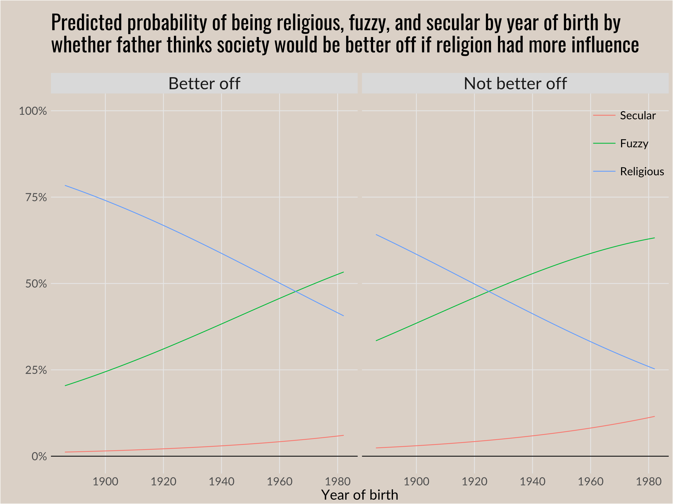
Notes:
Previously used ‘relig’ but has been updated with ‘reltrad.’ The main difference is fewer Protestants and more Other Religions, as most LDS (and some other smaller denominations) reported “Protestant” on ‘relig’ but is categorized as other religion in ‘reltrad’

Slide 23
Explaining across-cohort decline
Societal/cohort
Residual year of birth point to unmeasured societal factors
Familial/generation
The significance of parents’ values further shows that parents matter

Slide 24
What of the future of religion?
The presence of a general, slow process of decline, while significant, doesn’t negate processes of revival
If cognitive skills for managing the conflict between religion and secularity can be transmitted with religion, then the trajectory might change
Decline in traditionally Christian measures of religiosity, while significant to social life, can’t speak to other sources of religious life

Slide 25
Thank you
simon.brauer@duke.edu
simonbrauer.github.io (website)

Slide 26
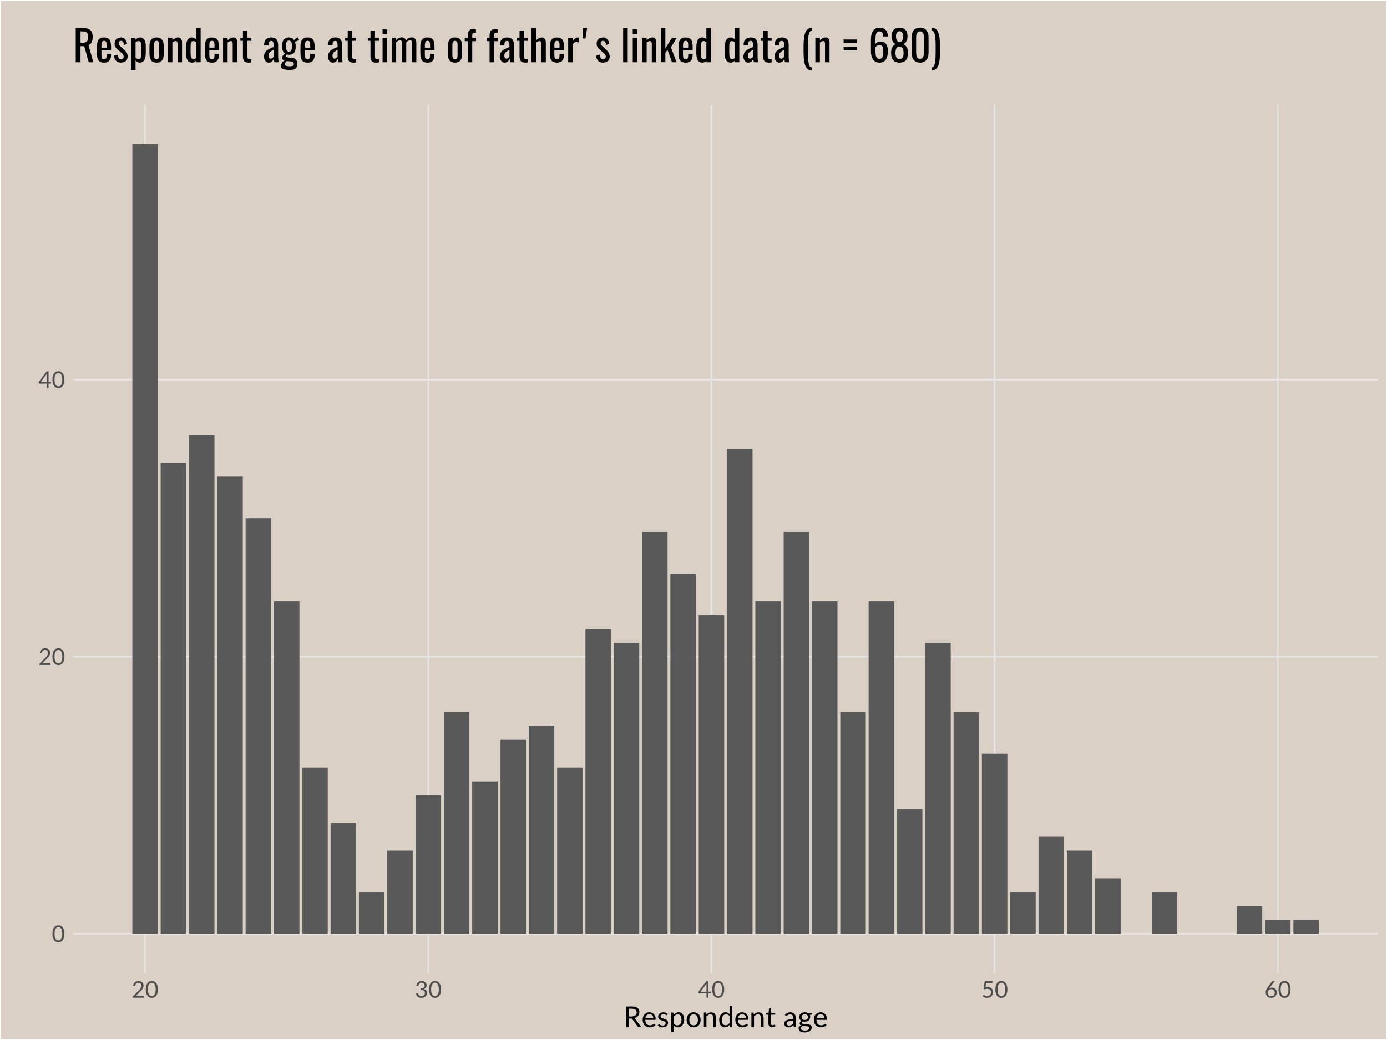

Slide 27
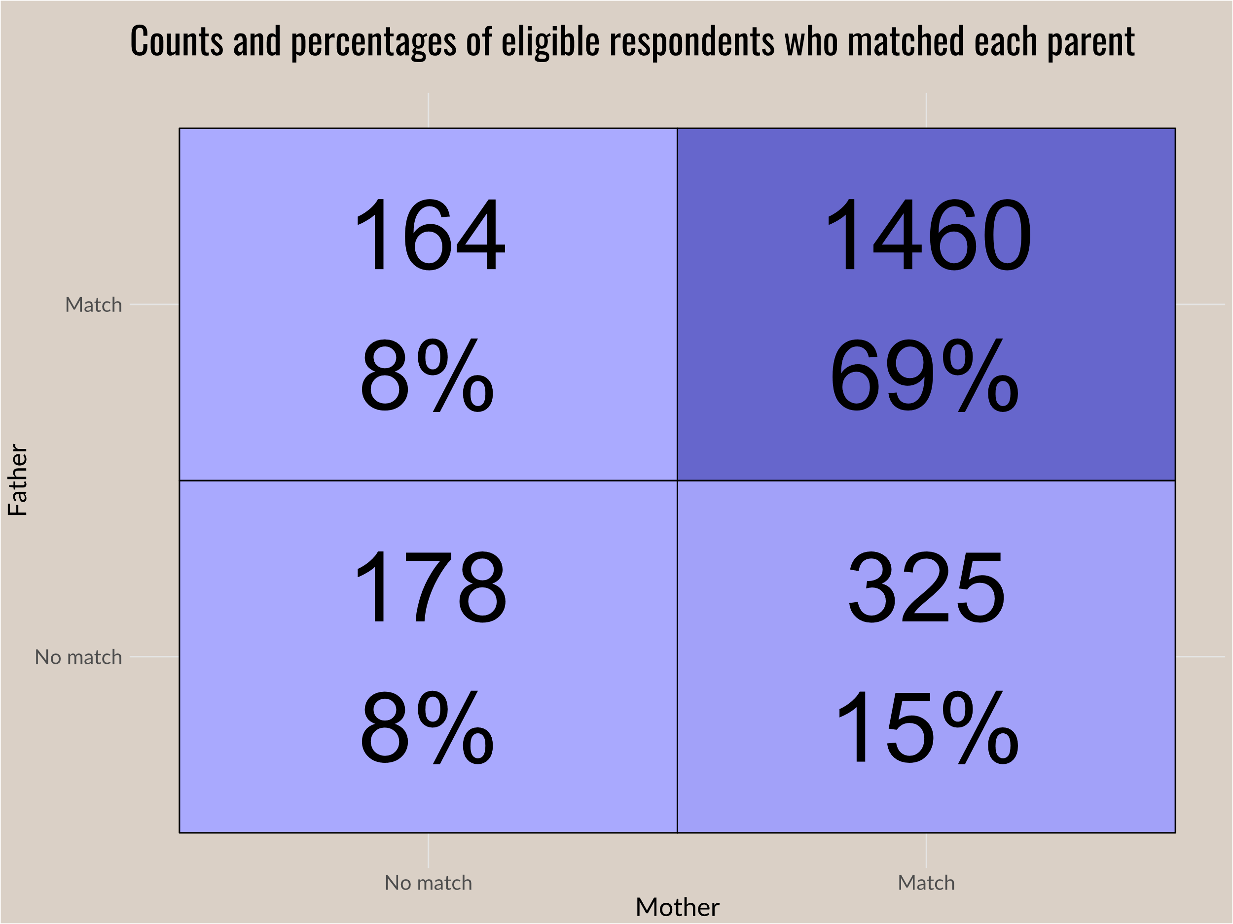

Slide 28
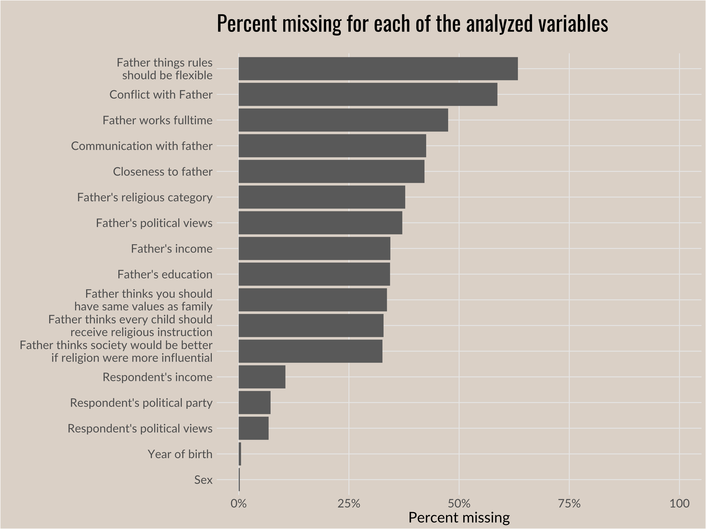

Slide 29
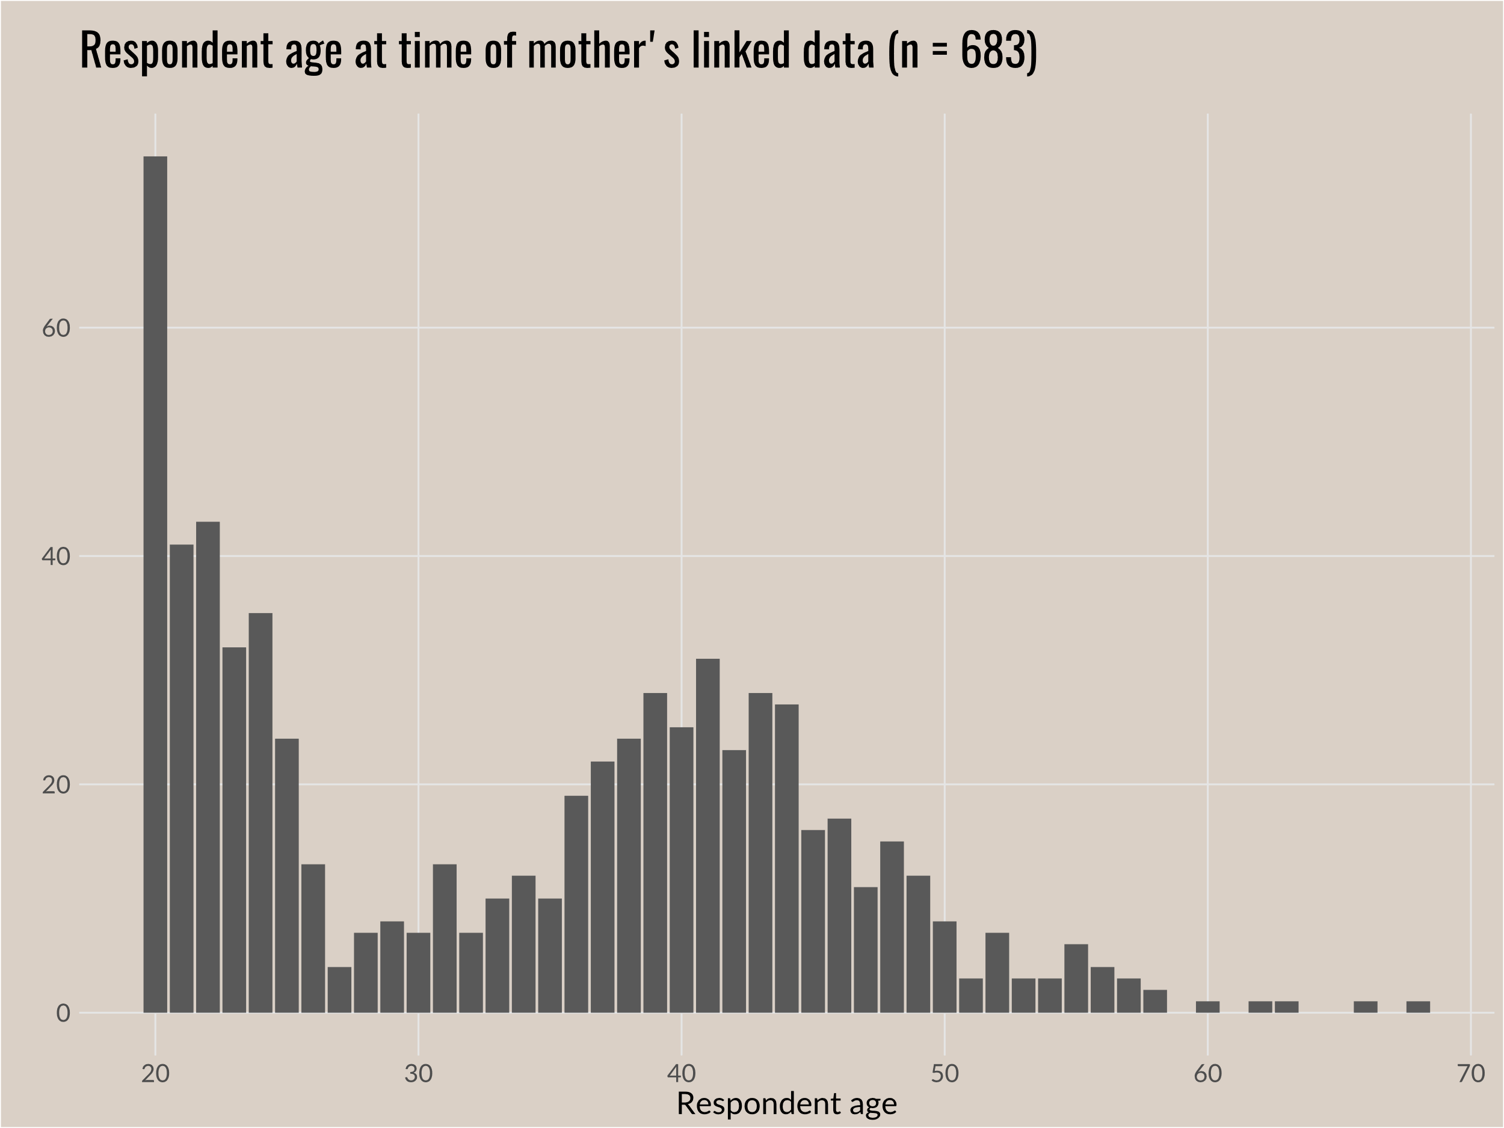

Slide 30
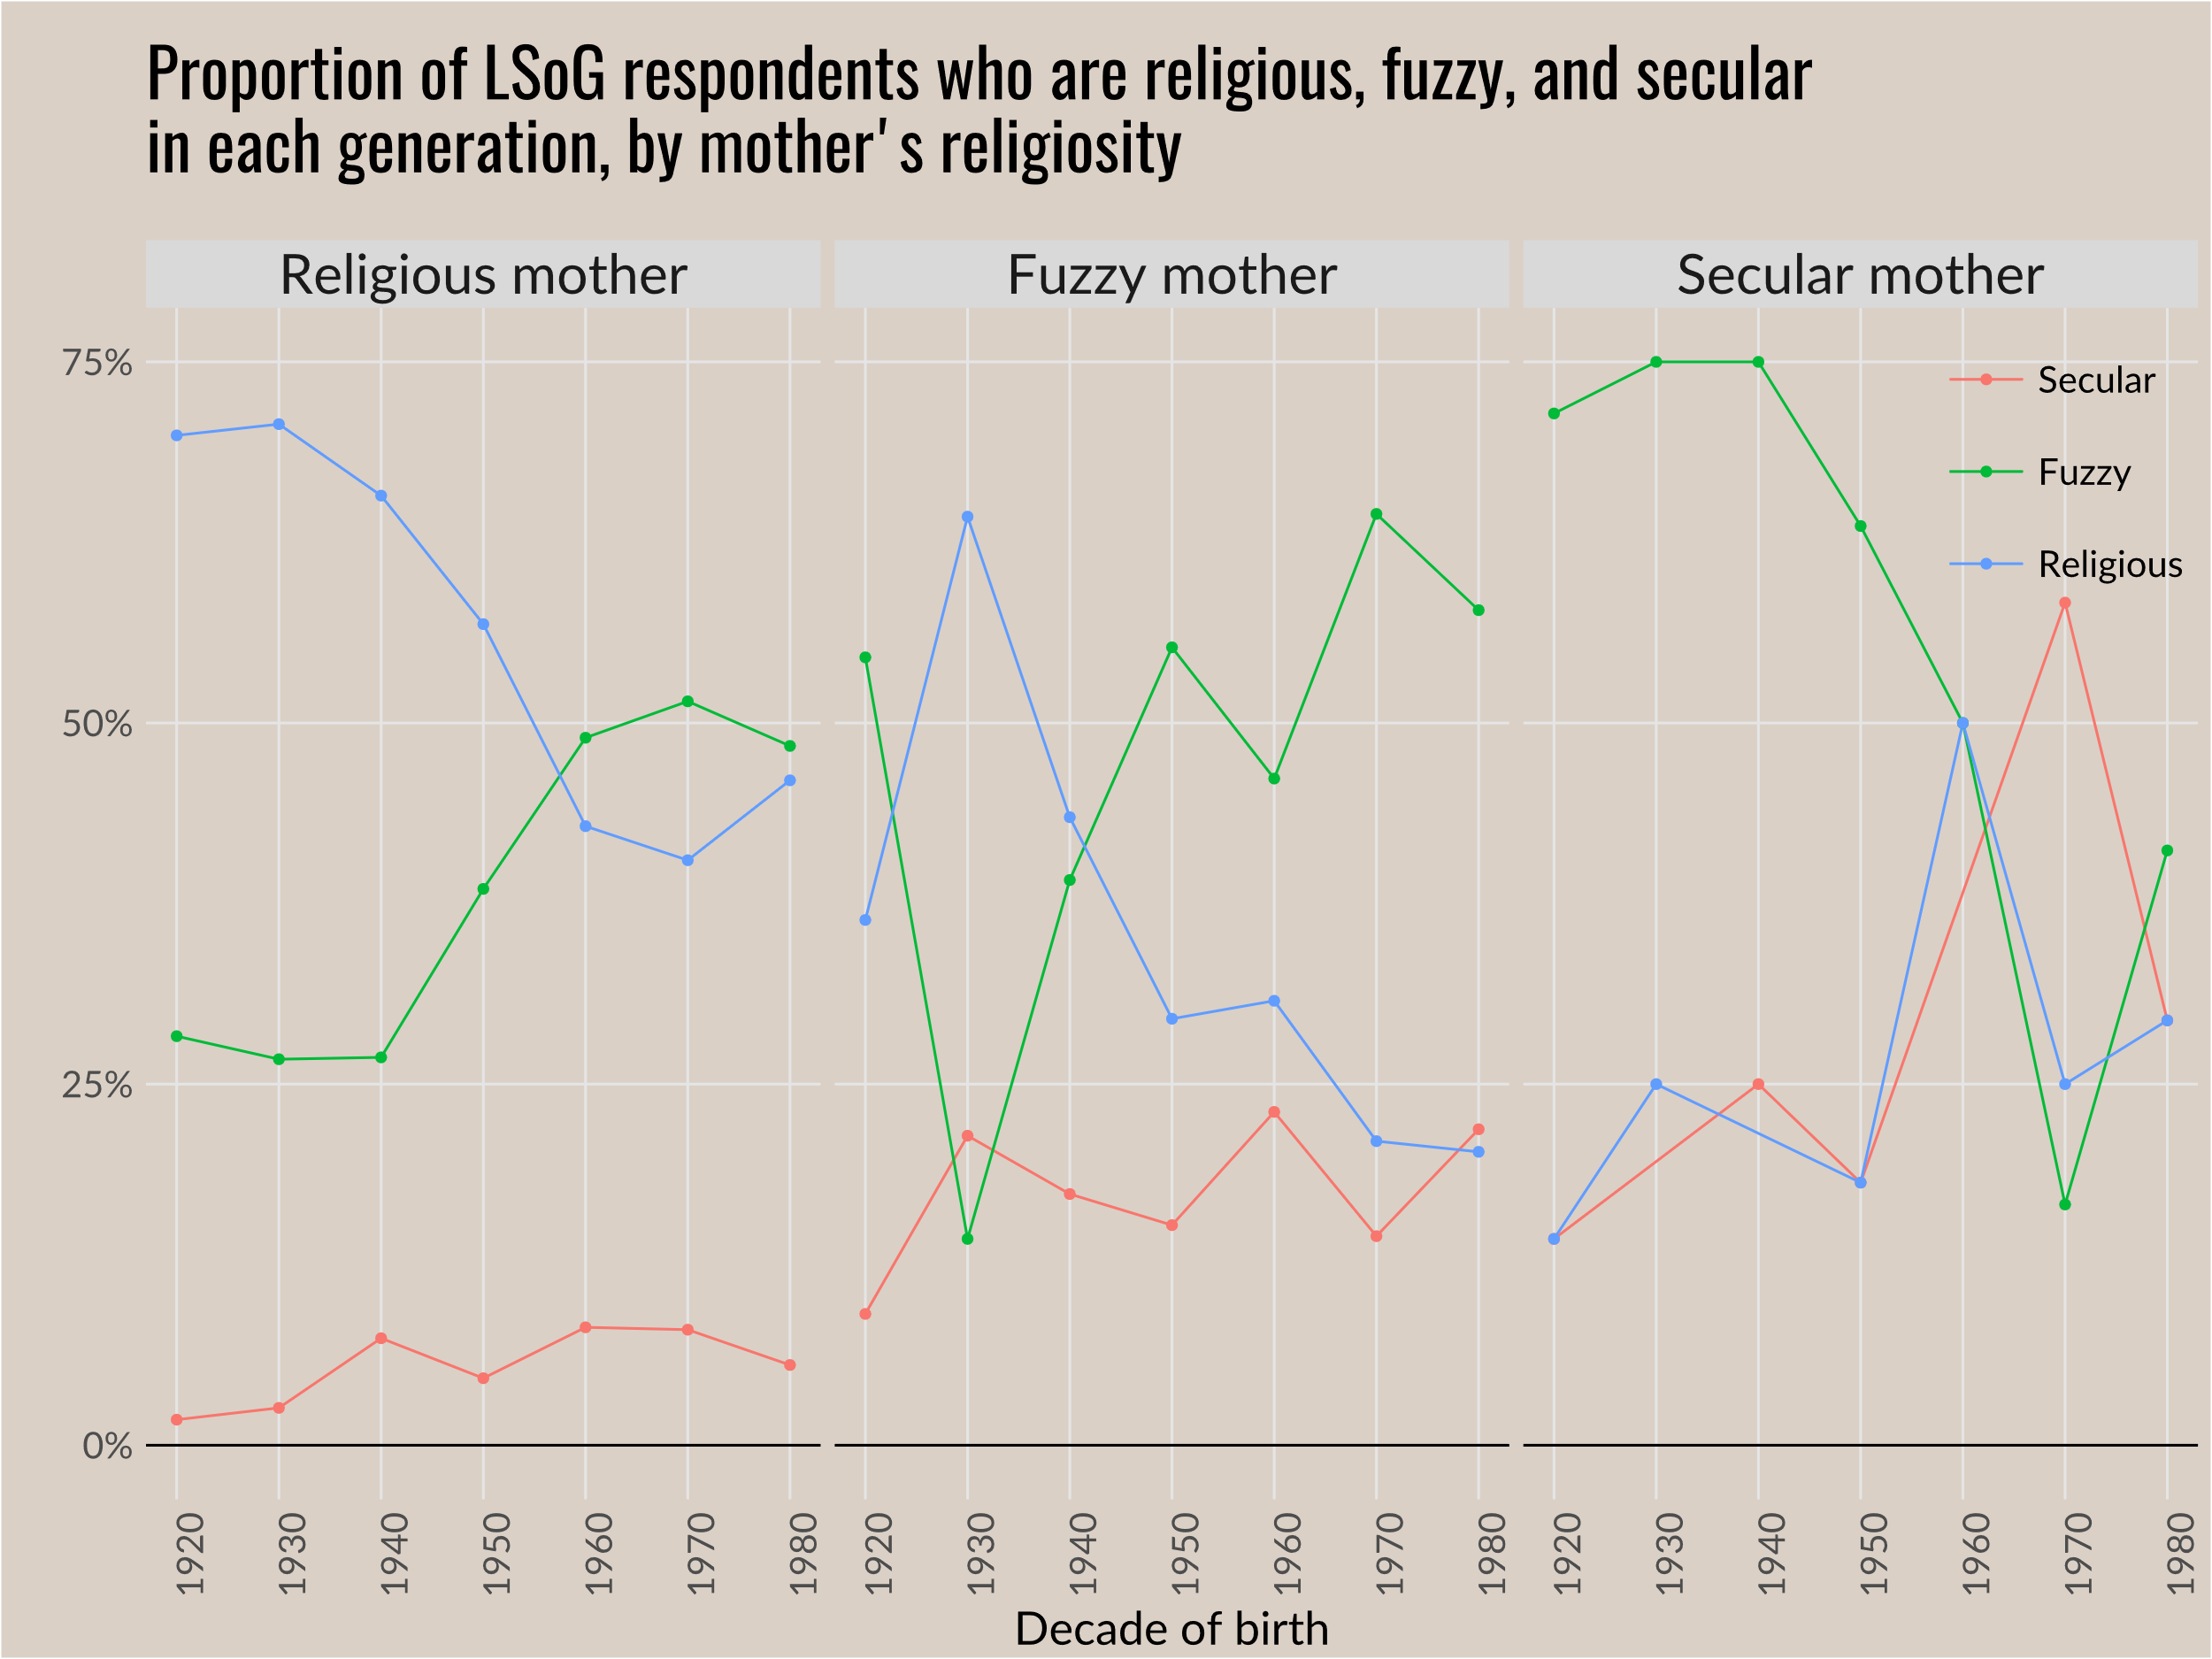

Slide 31
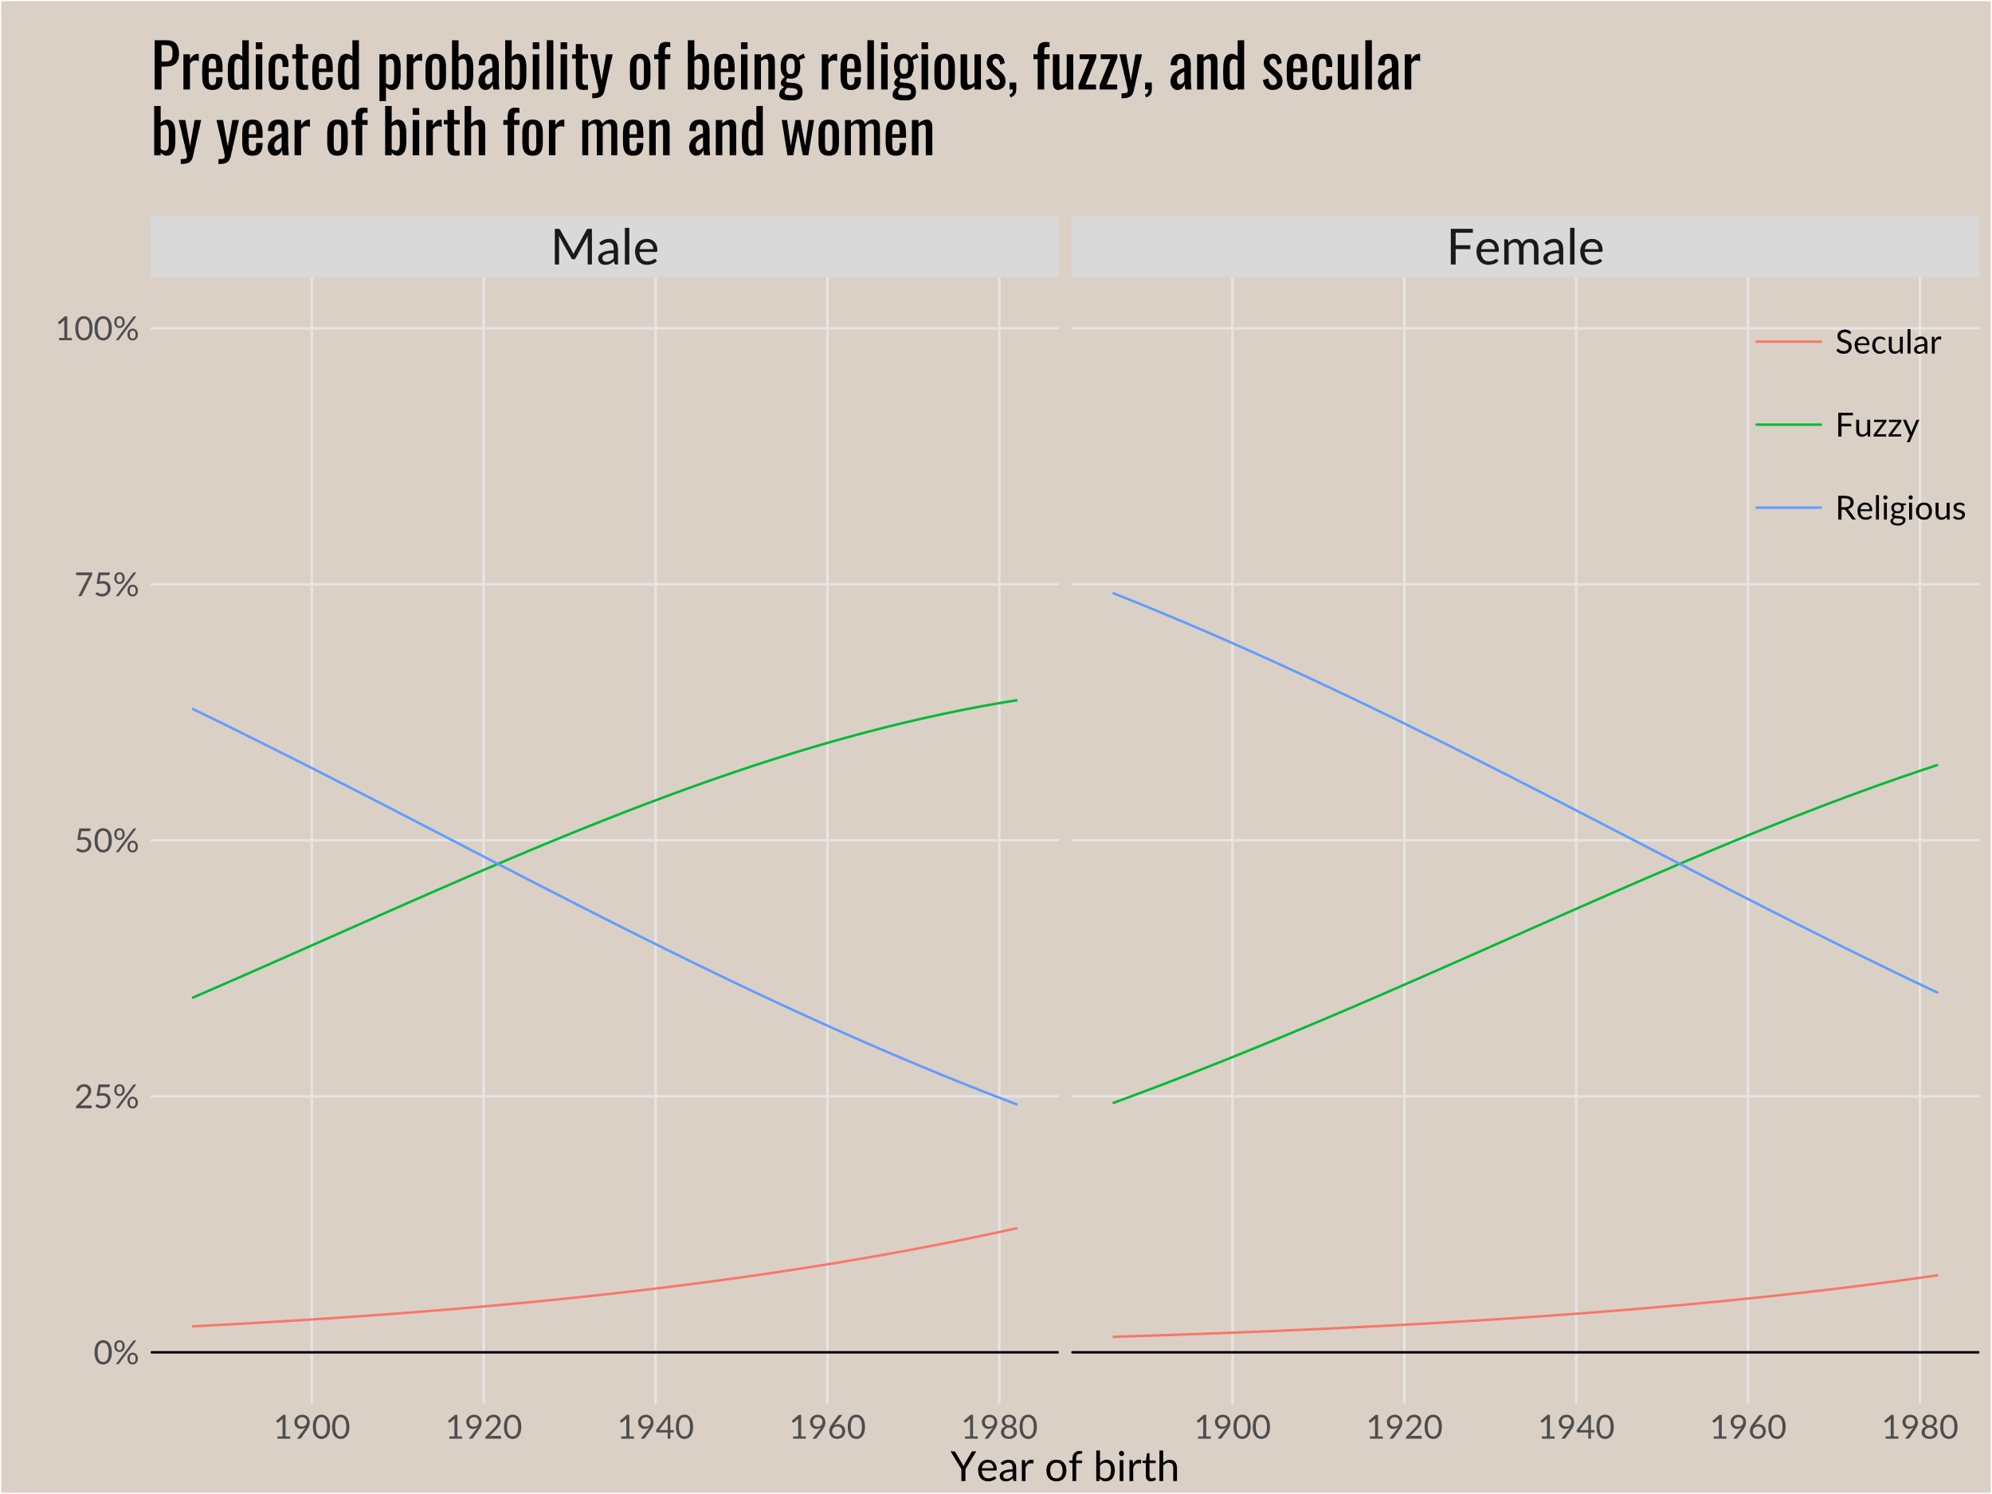
Notes:
Previously used ‘relig’ but has been updated with ‘reltrad.’ The main difference is fewer Protestants and more Other Religions, as most LDS (and some other smaller denominations) reported “Protestant” on ‘relig’ but is categorized as other religion in ‘reltrad’

Slide 32
Figure citations
Slide 2
Putnam and Campbell 2012. American Grace. p. 123
Hout and Fischer 2014. “Explaining Why More Americans Have No Religious Preference.” p. 429
Voas and Chaves 2016. “Is the United States a Counterexample to the Secularization Thesis?” p. 1542
Schwadel 2010. “Age, Period, and Cohort Effects on U.S. Religious Service Attandence.” p. 15
Pew Research Center 2012. “Nones” on the Rise. p. 16

Slide 33
Figure citations
Slide ____
Voas and Chaves 2016. “Is the United States a Counterexample to the Secularization Thesis?” p. 1542,1544,1545
Slide ___
Voas 2009. “The Rise and Fall of Fuzzy Fidelity in Europe.” p. 166

